Slide 1


Final Presentation
Smart Attend

Slide 2
Motivation:
We got motivated by observing some of the concerns faced by instructors like For
instructor its time taking to capture attendance manually in every class and observe
each individual performance and interest on subject.
Objective:
To bring ease in tracking the attendance for instructors.

Slide 3





Implementation Environment
1. MongoDB
2. Express.js
3. Angular 7
4. Node.js
5. Ionic 4
6. Android SDK
7. X-Code
8. Heroku

Slide 4
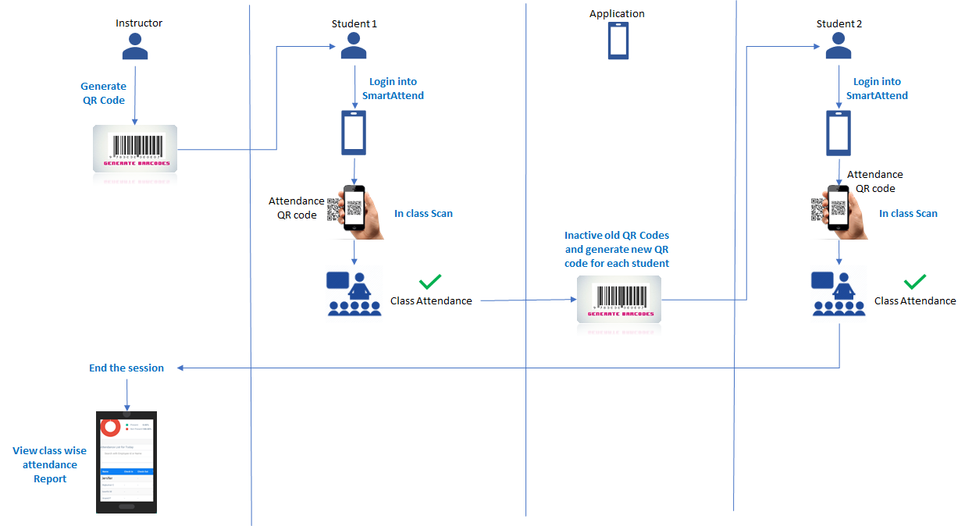
USE TRANSITIONS & SECTION DIVIDERS
Block Diagram
!
Consistency helps viewer see connections in the story – use same layout and design for individual sections and give your audience a mental check-point.

Slide 5
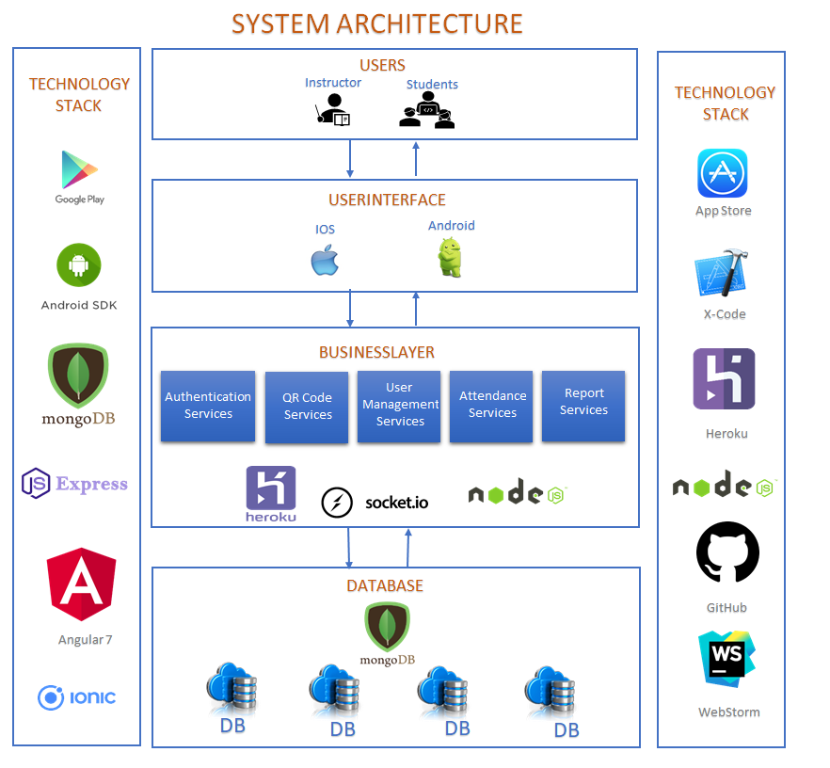
System Architecture

Slide 6

PRODUCT JOURNEY
Research
System Architecture Design
Follow up meet with Choi ma’am
Implemented 6 features
Follow up meet with Choi ma’am
March 5th,2019
2
Start
1
INCREMENT-1
INCREMENT-2
Bug Fixes
Enhancements (from feedback)
Implemented 3 features
Follow up mails with Choi ma’am
Bug Fixes
Enhancements (from feedback)
Implemented 2 features
Follow up meet with Choi ma’am
V1.0
MILESTONE 1
Version-1.0 Release
March 23rd,2019
4
3
INCREMENT-4
INCREMENT-3
Smart Attend
March 1st2019 - May 1st 2019
V1.1
MILESTONE 2
MORE MILESTONES
Version-1.1 Release
April 30th,2019
5
INCREMENT-5
X
X
XX
Journey Continues…..

Slide 7
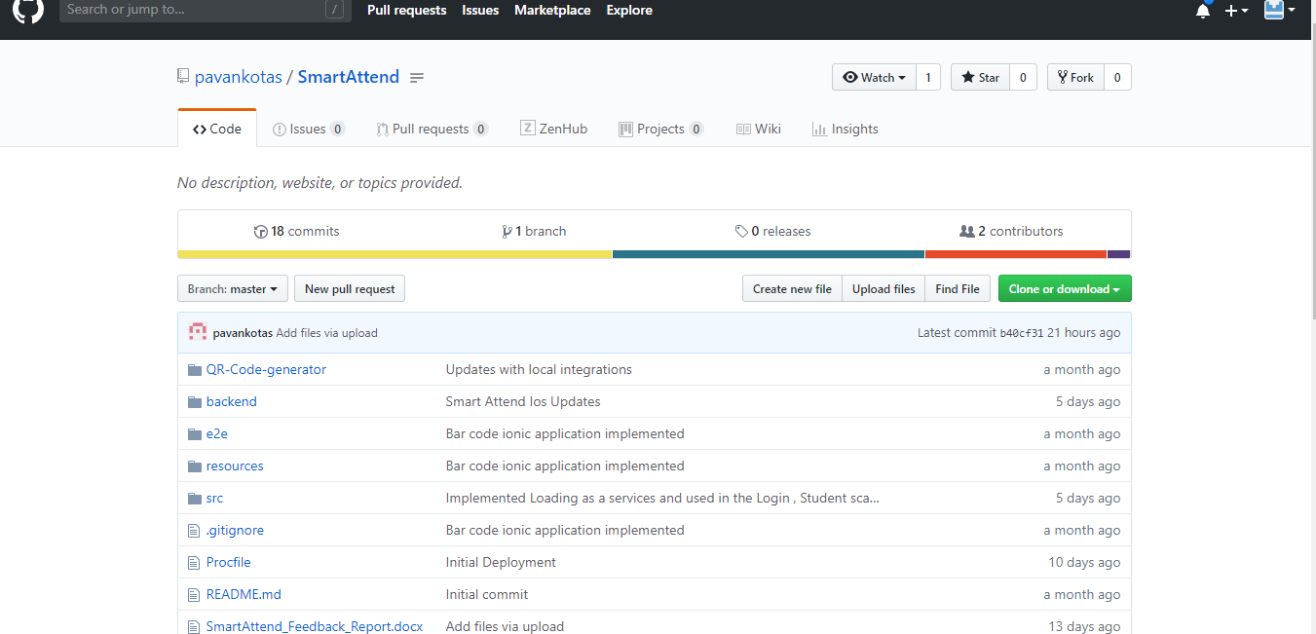
https://github.com/pavankotas/SmartAttend

Slide 8
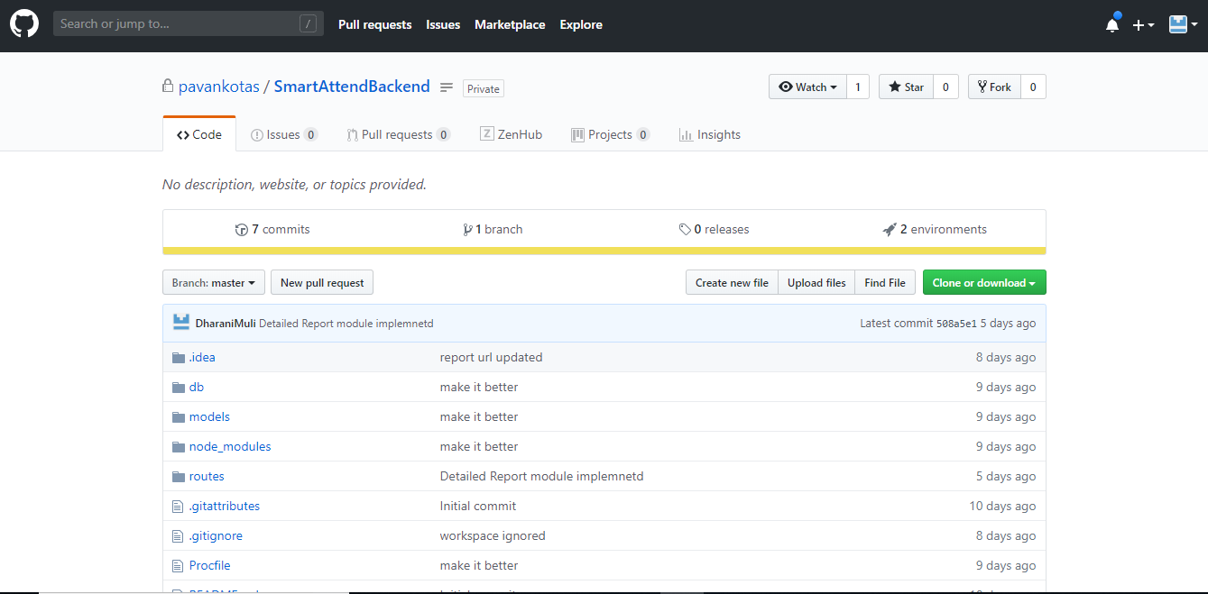
https://github.com/pavankotas/SmartAttendBackend

Slide 9
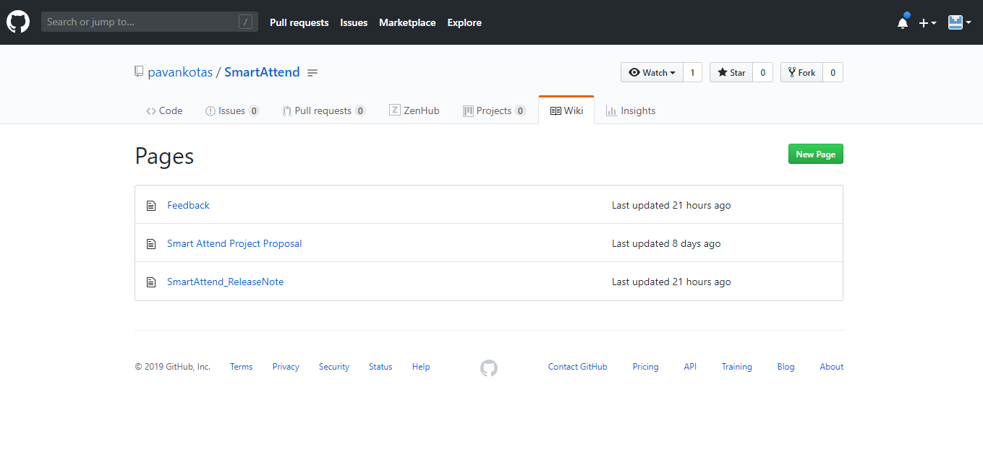
https://github.com/pavankotas/SmartAttend/wiki

Slide 10
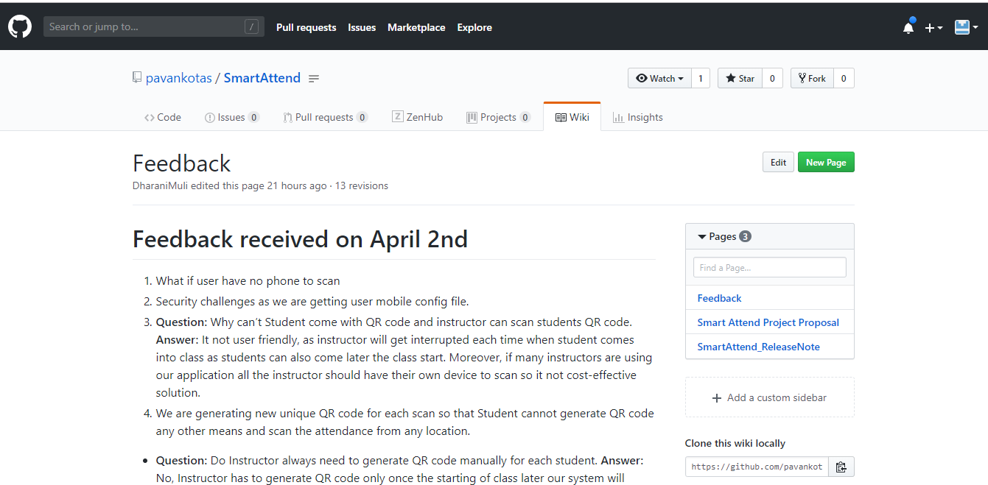
https://github.com/pavankotas/SmartAttend/wiki/Feedback

Slide 11
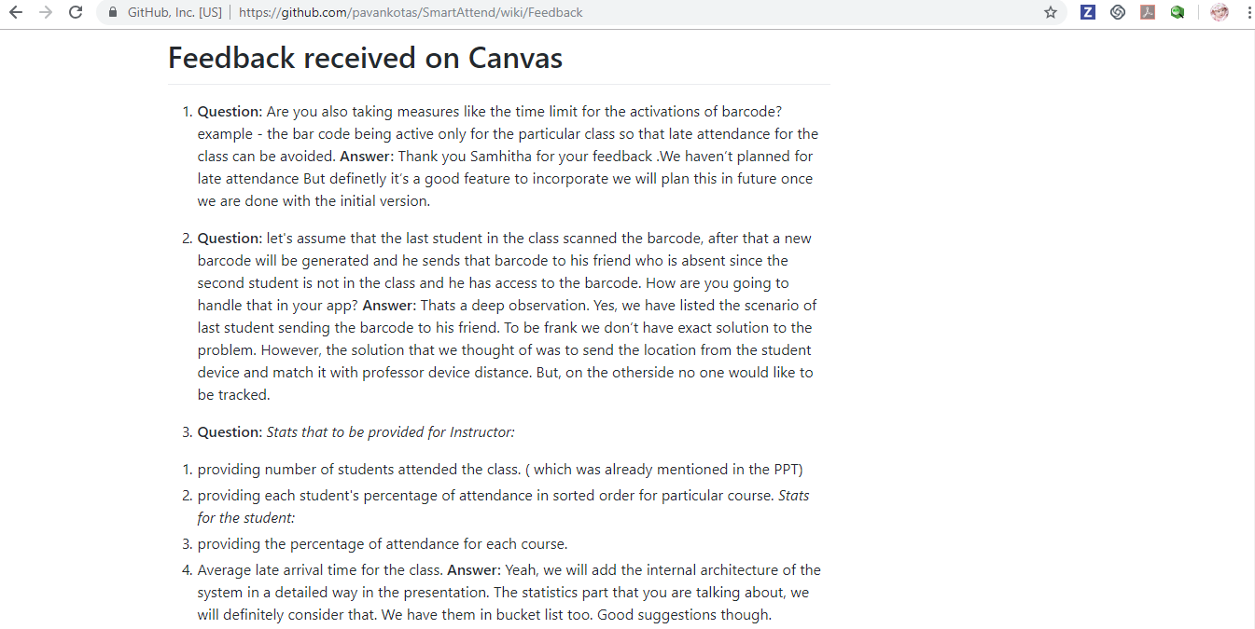
https://github.com/pavankotas/SmartAttend/wiki/Feedback

Slide 12

Future consideration:
Securable application.
User should request instructor to add attendance if they user is unable to
take the attendance.
Ex: if student don’t have phone.
Build Statistics
Late Attendance tracker
Course wise attendance.
Enhancements in Reports
Make Robust

Slide 13
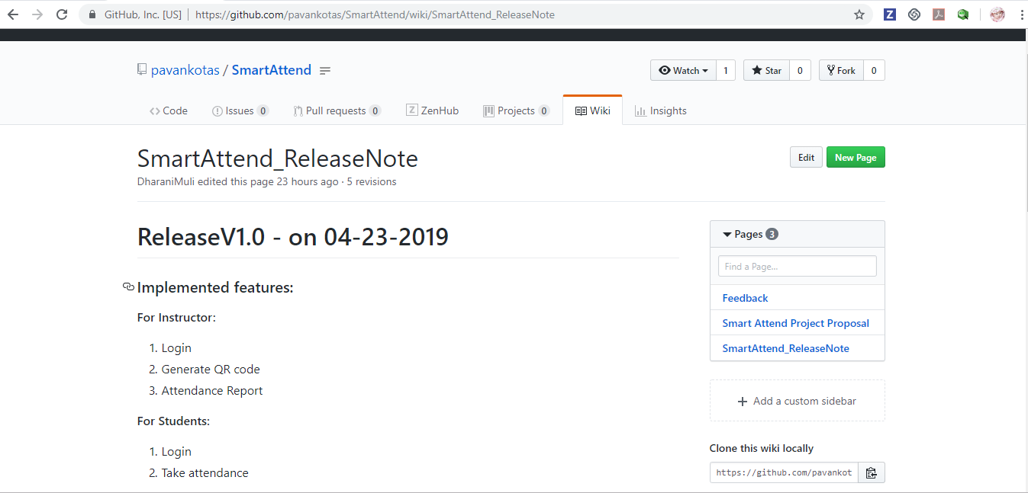
https://github.com/pavankotas/SmartAttend/wiki/SmartAttend_ReleaseNote

Slide 14
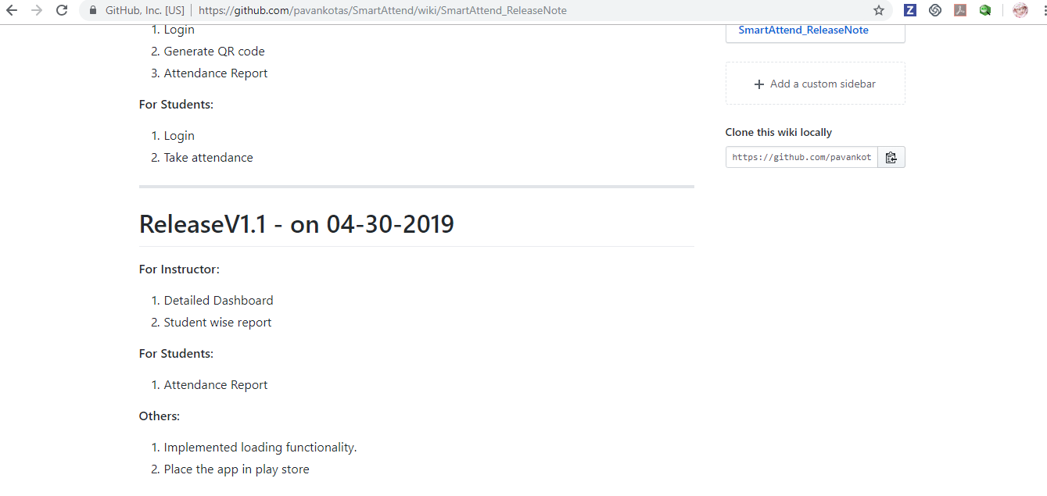
https://github.com/pavankotas/SmartAttend/wiki/SmartAttend_ReleaseNote

Slide 15
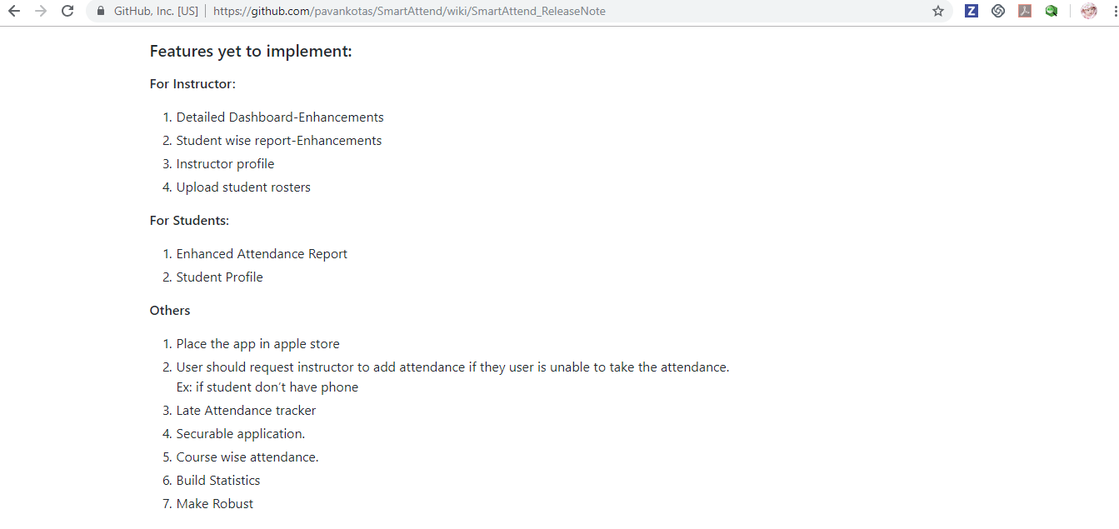
https://github.com/pavankotas/SmartAttend/wiki/SmartAttend_ReleaseNote

Slide 16
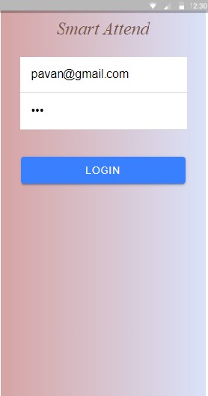
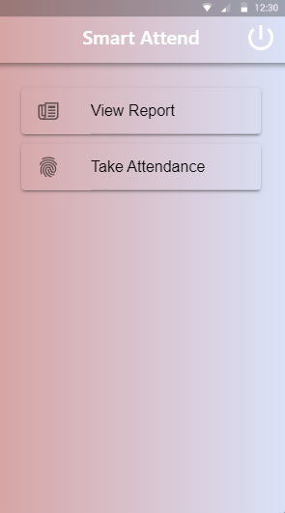
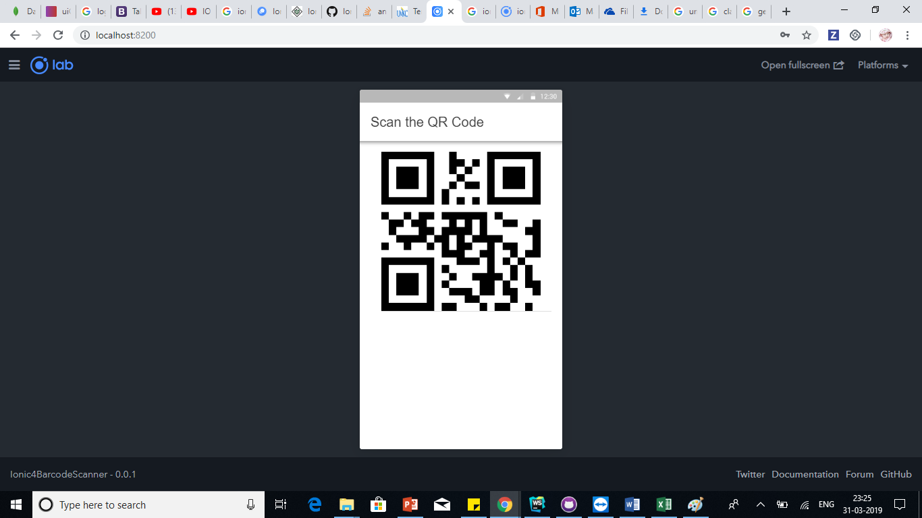
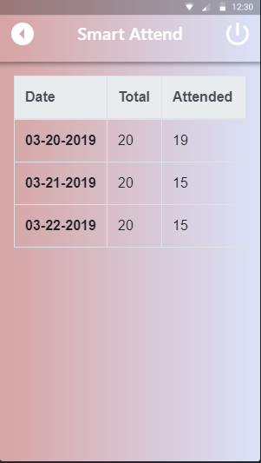
Professor Login
Home Page
Take Attendance
View Report

Slide 17
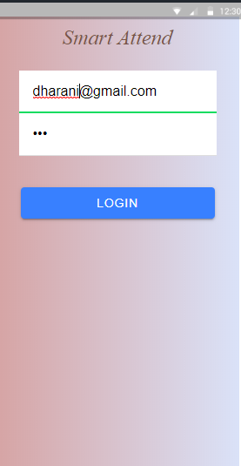
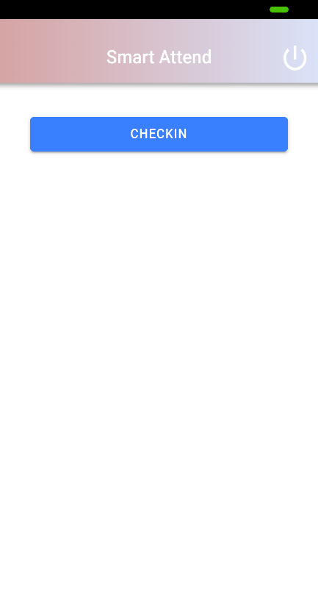
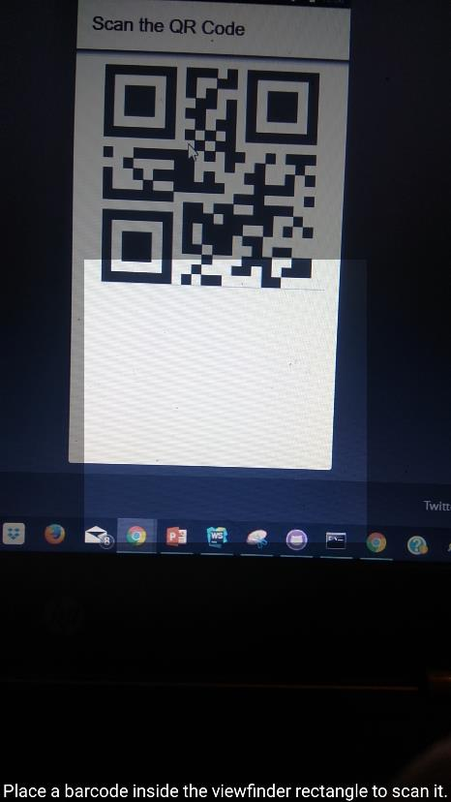
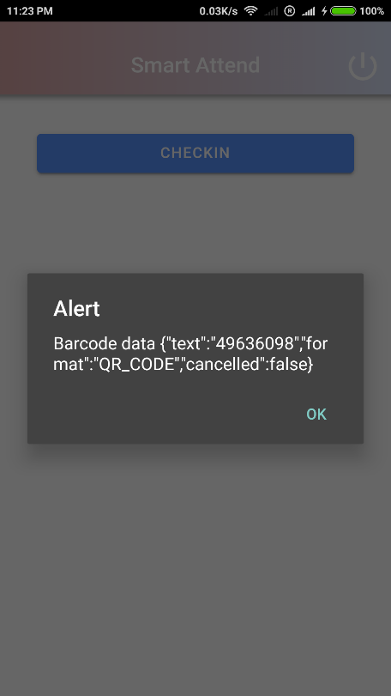
Student Login
Check in
Scan QR Code
Alert

Slide 18
Final Presentation
Smart Attend V1.1

Slide 19
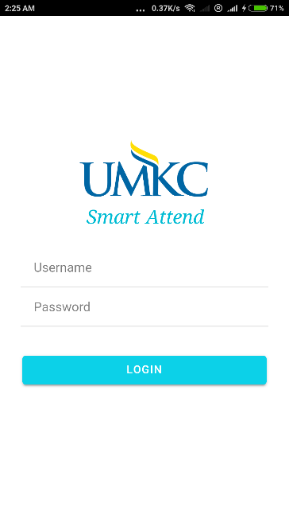
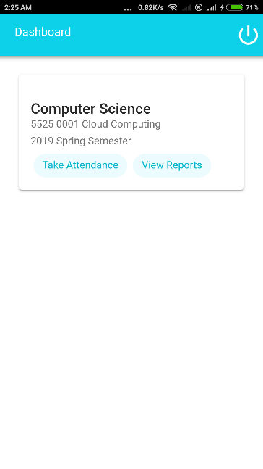
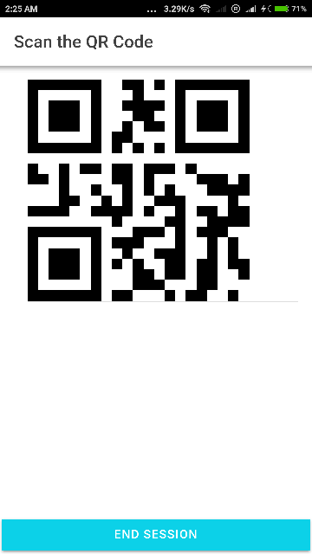
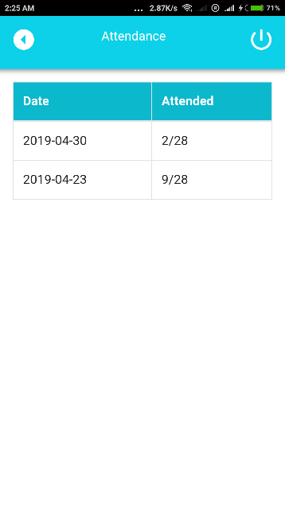
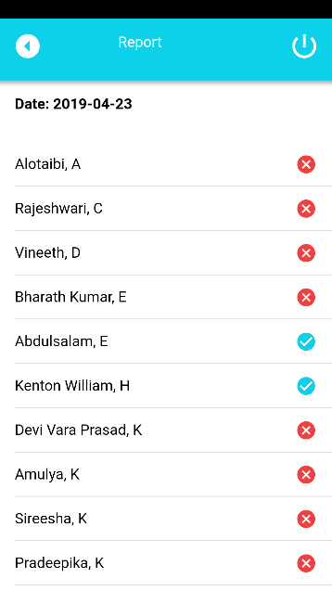
Android : Instructor app Screenshots
Screenshots

Slide 20
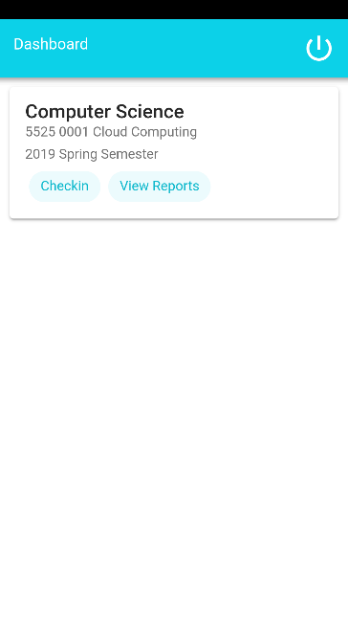
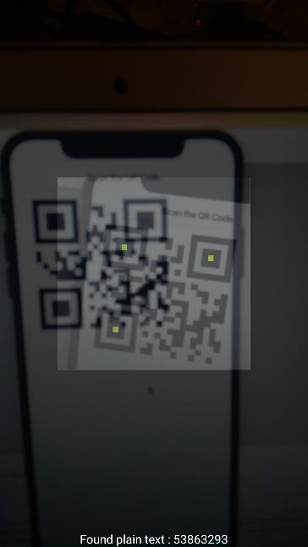
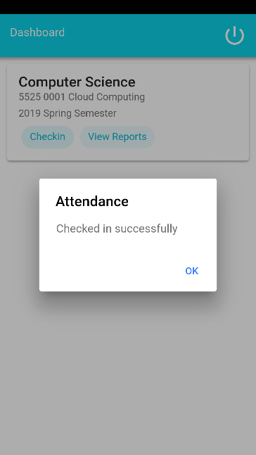
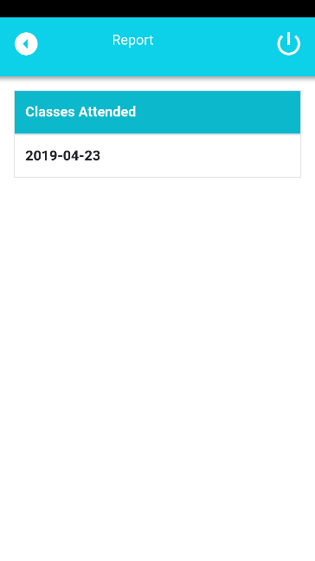
Android : Student app Screenshots
Screenshots

Slide 21
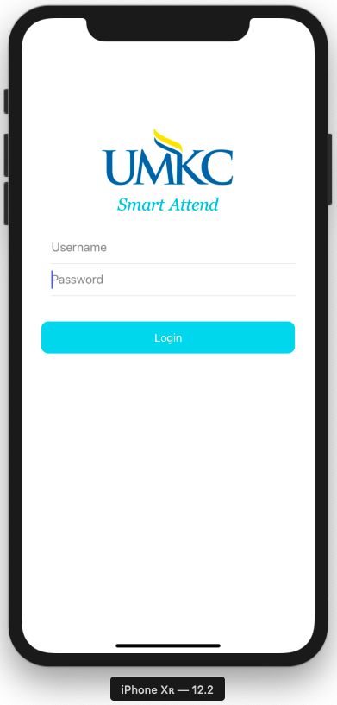
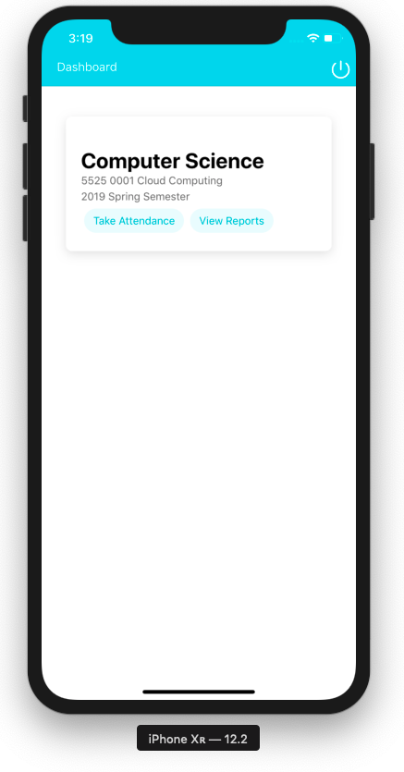
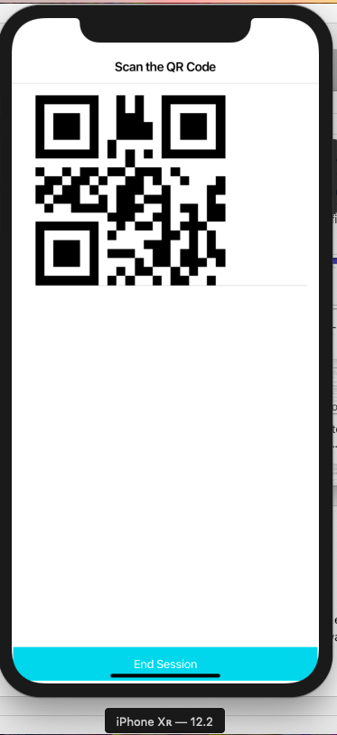
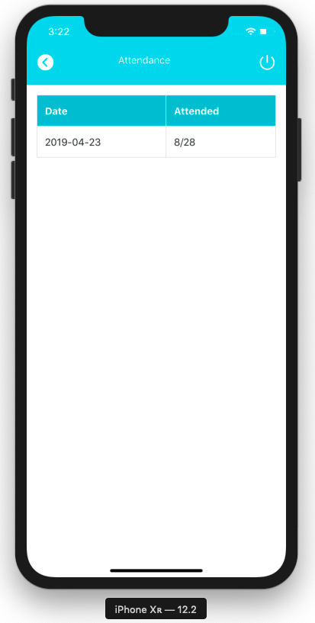
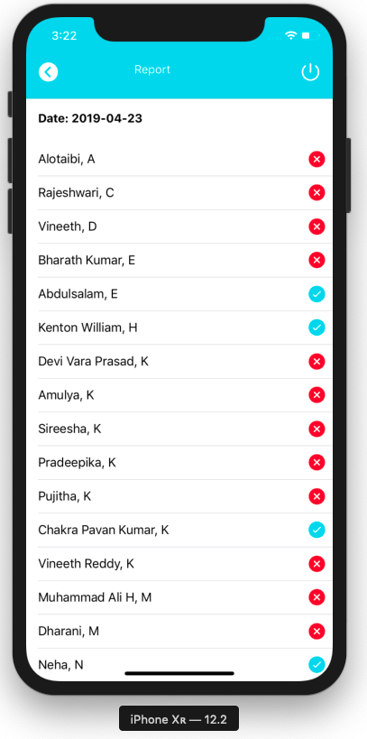
IOS : Instructor app Screenshots
Screenshots

Slide 22
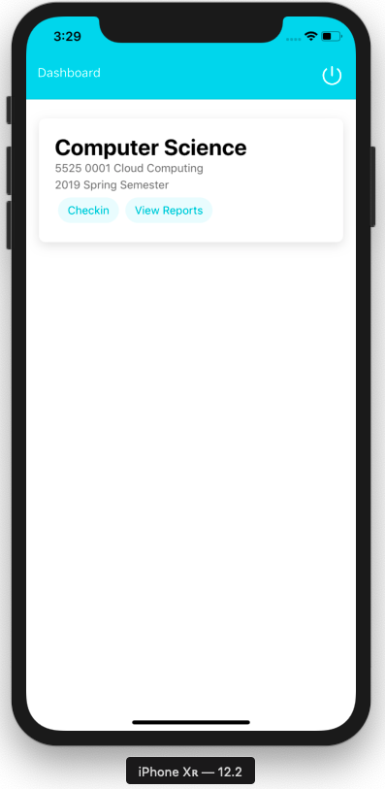
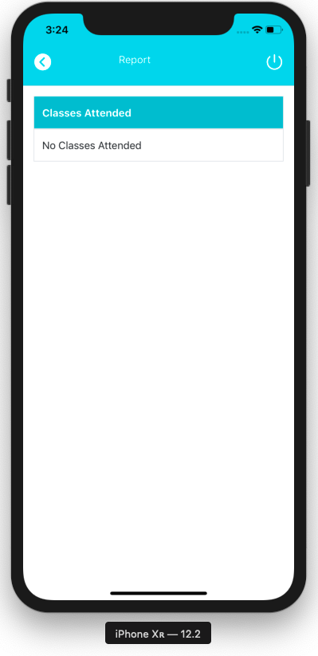
IOS : Student app Screenshots
Screenshots

Slide 23

Challenges and New Findings
“How much text should I use?”
Consider when you give a paper handout in a meeting—everyone’s head goes down and they read, rather than staying heads-up and listening.
“But this is important to the understanding of the story”
Avoid using sentences that will already be used when talking
“More words, less sentences”
Focus on action words that will enhance the viewer experience

Slide 24
CA
Challenges and New Findings
“How much text should I use?”
Consider when you give a paper handout in a meeting—everyone’s head goes down and they read, rather than staying heads-up and listening.
“But this is important to the understanding of the story”
Avoid using sentences that will already be used when talking
“More words, less sentences”
Focus on action words that will enhance the viewer experience

Slide 25

Product Outcomes
1
Build a real time application where in UMKC students and instructors use our application for collaboration, in class attendance maintenance and retrieve analytics on student’s class presence.
2
Should be compatible.
3
Should be cross platform.

Slide 26
Individual Outcomes
Team
Chakra Pavan Kumar, Kota
Dharani Muli
From this project I would like to get hands on experience on different tools and technologies
Also gain knowledge of the best coding standards.
I will improve my collaboration skills working in a team.
By end of the project I would like to have hands-on experience on mentioned software tools.
Explore the functionalities of cloud services.
I will learn and collaborate efficiently as an individual, as a team.

Slide 27
THE STAGE HAS BEEN SET go ahead and follow the basic 5 steps
1
2
3
4
5
Understand your brand and audience; speak in an authentic voice
Get your facts straight with 5 W’s
The power of specifics, details, and imagery
Show, don’t tell
Know the end at the beginning
Reference : The basics you can find anywhere 5 Steps To Successful Storytelling Published on April 5, 2014 Featured in: Marketing & Advertising

Slide 28
BECAUSE STORYTELLING, AND VISUAL STORYTELLING, WAS PUT IN THE HANDS OF EVERYBODY,
WE HAVE ALL NOW BECOME STORYTELLERS.
—LEVAR BURTON

Slide 29
Smart Attend
Thank you

